Slide 1

MongoDB
ADDING MONGODB TO YOUR APPLICATION
by Nick Virag

Slide 2
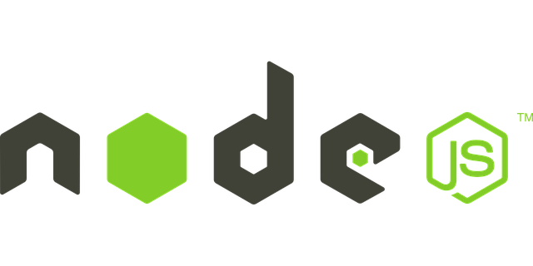
Local Node.js Server
ADDING MONGODB TO YOUR APPLICATION
Server-side JavaScript
Single threaded
Non-blocking I/O
Event driven

Slide 3
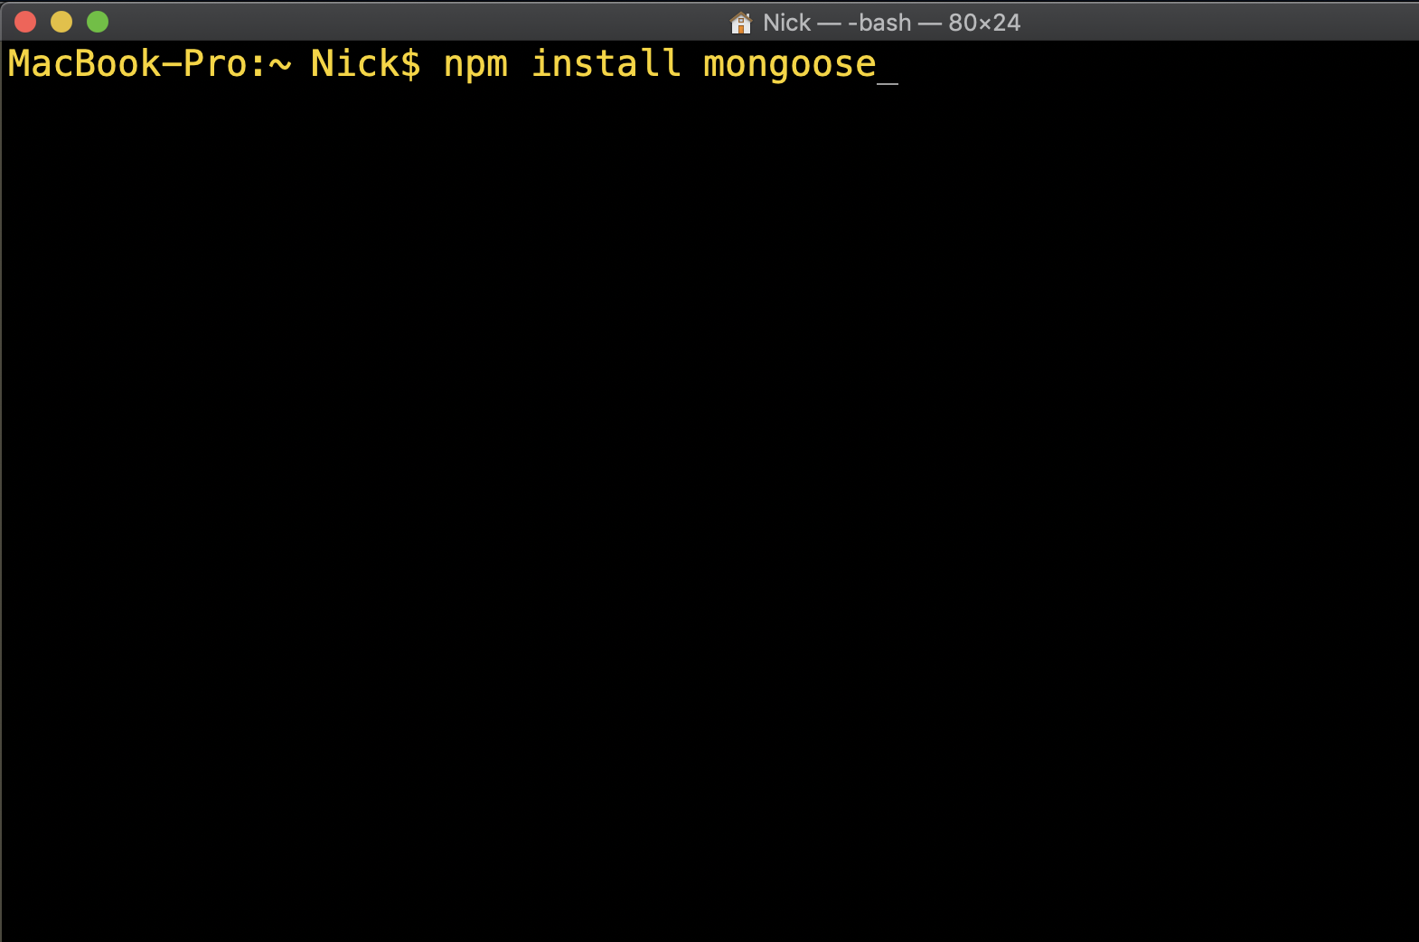
Package Manager
ADDING MONGODB TO YOUR APPLICATION
NPM
Package.json
Install, update, delete
Collaboration
Lock file

Slide 4
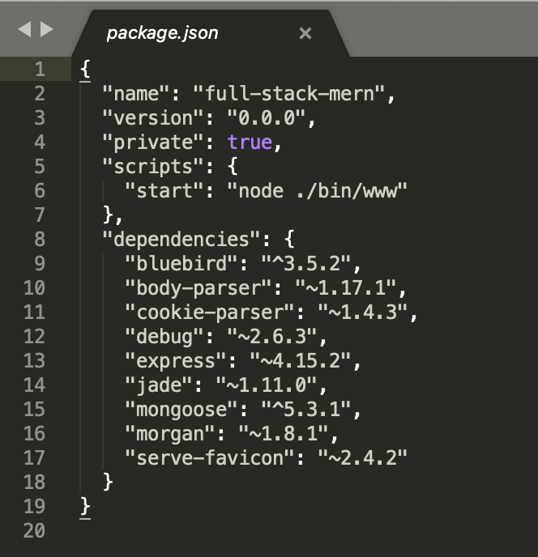
Dependencies
ADDING MONGODB TO YOUR APPLICATION
Express
Bluebird
Body Parser
Mongoose

Slide 5
Express.js
ADDING MONGODB TO YOUR APPLICATION
Framework for web applications
Web APIs & Endpoints
Micro-services
RESTful architecture

Slide 6
RESTful APIs
ADDING MONGODB TO YOUR APPLICATION
Atomic
Stateless
CRUD operations
Predictable

Slide 7
Domain Driven Design
ADDING MONGODB TO YOUR APPLICATION
Reusable code
Separation of concerns
Business logic
D R Y
Easily scalable
on’t
epeat
ourself

Slide 8
Domain Driven Design
ADDING MONGODB TO YOUR APPLICATION
1-1 comparison to real-world objects
USER
SNACK
PREP

Slide 9
What does DDD mean for MongoDB?
ADDING MONGODB TO YOUR APPLICATION
Separate and abstract.
ENDPOINTS
EXPRESS
CONTROLLERS
SCHEMA
MODEL METHODS

Slide 10

Endpoints & Controllers
ADDING MONGODB TO YOUR APPLICATION
Endpoints describe the request
Controllers invoke a method
Object Relational Mapping
Side effects

Slide 11

Testing an API from the beginning
ADDING MONGODB TO YOUR APPLICATION
POSTMAN
Simulate requests
Test your responses
Save common requests
Test different scenarios

